Slide 1
Introduction to Programming
Variables and statements

Slide 2
Visual Studio Code and GCC
Mac users - gcc is natively installed
Windows users - http://tdm-gcc.tdragon.net/download
Visual Studio Code - https://code.visualstudio.com/

Slide 3
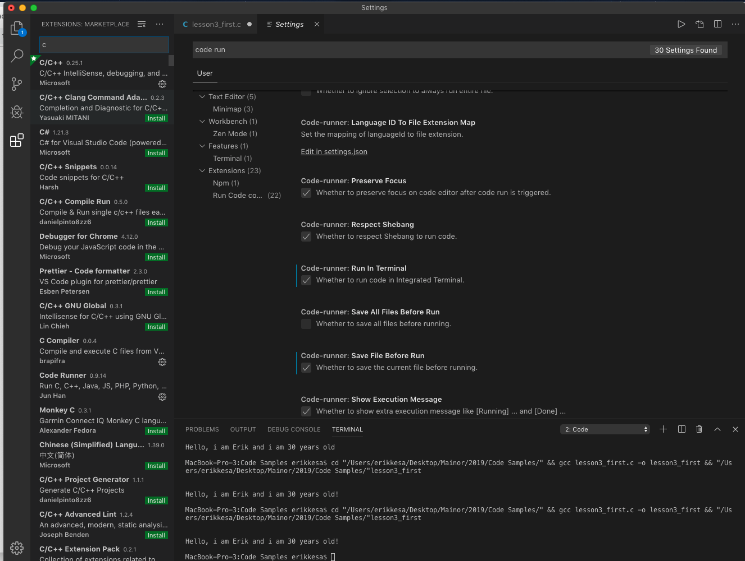
VS Code - Recommended addons

Slide 4
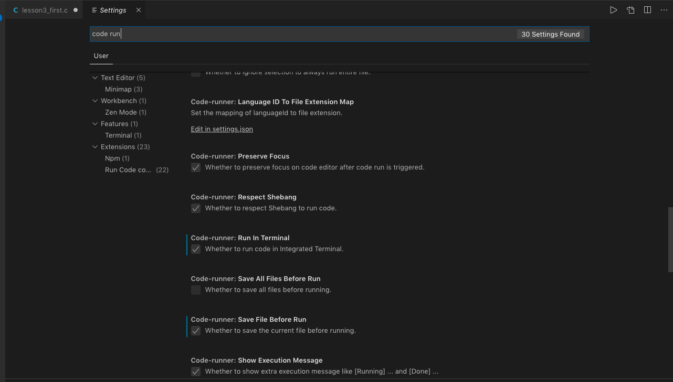
VS Code – Recommended settings

Slide 5
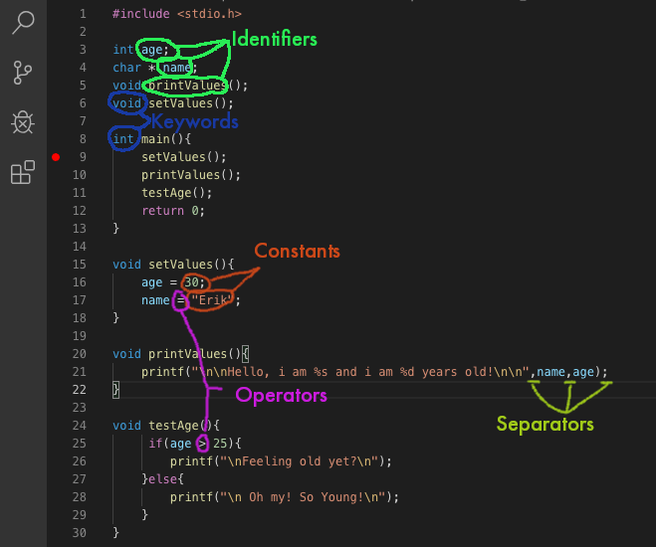
Core language elements
Identifiers
Keywords
Constants
Operators
Separators
White Space

Slide 6
Identifiers
Identifiers are sequences of characters (words or combinations of words) used for naming variables, functions, new data types, and preprocessor macros. You can include letters, decimal digits, and the underscore character ‘_’ in identifiers. (2)

Slide 7
Keywords
Keywords are special identifiers reserved for use as part of the programming language itself. You cannot use them for any other purpose.(3).
They allow the programmer to use basic concepts – like branching (if, else, …) or loops (for, while)
They also offer basic types to store data (int, char,…)

Slide 8
Constants
Integer Constants:
Decimal: 23,34,1
Hexadecimal: 0x23F
Octal: 0123
Constants are the direct values used in an algorithm. They will be converted into binary format upon compilation for the processor to be able to operate on them. (add, subtract, …)

Slide 9
Constants
Real number constants:
3.14
x = 5e2; /* x is 5 * 100, or 500.0. */
y = 5e-2; /* y is 5 * (1/100), or 0.05. */

Slide 10
Constants
String Constants:
“hello, world”

Slide 11
Constants
Character Constants:
’c’ ,
‘\n’ - newline character,
‘\t’ - tab

Slide 12
Operators
An operator is a special token that performs an operation, such as addition or subtraction, on either one, two, or three operands (provided either as variables, constants or the return values of functions). Basic operators correlate to specific circuitries within the ALU (arithmetic logic unit) of the processor and they produce some sort of result, that can either be stored in a variable, or operated on further.

Slide 13
Mathematical Operators
+ - addition
- - subtraction
* - multipiclation
/ - division
% - modulus
++ - value increment
-- - value decrement

Slide 14
Relational Operators
== - Compares the VALUES of two operands
!= - Compares for inequality
> - Greater than
< - less than
<= - less-equal
>= - greater-equal

Slide 15
Logical Operators
&& - and
|| or
!() - not

Slide 16
Separators
A separator separates tokens. White space (see next section) is a separator, but it is not a token. The other separators are all single-character tokens themselves:
( ) [ ] { } ; , . :

Slide 17
Variables
A variable is a name given to a memory location to store some sort of data that your program will operate on.
Variable DECLARATION assigns the name to a memory location, but does not initialize it. This lets the computer know we intend to use it.
Variable DEFINITION assigns value to a declared variable, thereby initializing it with the given type. This
Basic syntax: [storage class] [extended type] type name;
Variable types in c - int, char, float, double, void
Extended types - long, signed, unsigned, short
Storage classes – auto, register, static, extern

Slide 18
Output
The printf(const char * format, …) function - will write the c string into standard output based on the format specified
https://www.gnu.org/software/libc/manual/html_node/Table-of-Output-Conversions.html

Slide 19
Exercise 1:
Link has retired from facing Ganondorf, settled down with Zelda and taken up farming has come to you with a problem – he has to pay land tax, but does not know how much. He knows that his land is rectangular, 500m long and 300m wide and that the cost for land in Hyrule is 20 rupees per m2, but since his education was lacking due to spending his youth breaking pots and saving Zelda instead of studying, he does not know how to calculate it. Write a C program to help him out!

Slide 20
Input
The scanf(”%d”, &var) function - will read user input specified by the format specifier (first argument) and store it into the memory address specified. (second argument). This example will accept an integer value.

Slide 21
Exercise 2:
Mario has decided to retire from plumbing and open a pizza restaurant. He has tasked you with creating a pizza dough calculator to avoid spending too much coin on surplus pizza dough. He says that a cm2 of pizza uses about 10 grams of pizza dough, and his menu offers pizzas based on diameter so that’s how he wants to enter the data.

Slide 22
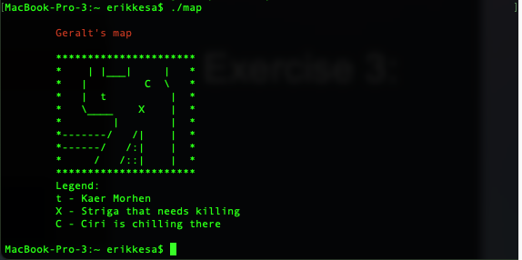
Exercise 3:
Geralt of Rivia has gone digital, and now, instead of using paper maps, he wants to use a computer to guide him on his many adventures. Since it’s the middle ages there, full-color displays and window based operating systems are not yet available. Write a program, that draws an ASCII-art map with the dimensions of 20x8, a border and with a tab offset.
Using colors in standard output - https://www.theurbanpenguin.com/4184-2/
Notes:
#include <stdio.h>
int main(){
printf("\n");
//Set color to red
printf("\t\033[0;31m");
printf("Geralt's map\n");
//Reset back to black
printf("\033[0m");
printf("\n");
printf("\t**********************\n");
printf("\t* | |___| | *\n");
printf("\t* | C \\ *\n");
printf("\t* | t | *\n");
printf("\t* \\____ X | *\n");
printf("\t* | | *\n");
printf("\t*-------/ /| | *\n");
printf("\t*------/ /:| | *\n");
printf("\t* / /::| | *\n");
printf("\t**********************\n");
printf("\tLegend: \n");
printf("\tt - Kaer Morhen\n");
printf("\tX - Striga that needs killing\n");
printf("\tC - Ciri is chilling there\n");
printf("\n");
return 0;
}

